Slide 1
Hierarchal task analysis
HTA

Slide 2
Task Analysis
Task analysis is the process of analyzing the way people perform their jobs:
the things they do
the things they act on and
the things they need to know.

Slide 3
Task Analysis
Task analysis gathers
  Procedural knowledge : task sequences, goals and sub-goals
  Also dependencies among the tasks
  Objects involved in achieving those tasks
Originally a tool for writing training manuals, now used more widely in business process analysis

Slide 4
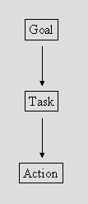
Task - Decomposition

Slide 5
The difference is ...
Goal - state of the system that a human wants to accomplish.
Task - activities required, used, or deemed necessary to achieve a goal.
Actions - steps required to complete the task. No cognitive processing.

Slide 6
Task: Steps to come to university

Slide 7
Task: Steps to eat food

Slide 8
Example
What are the steps to come to university?
  STEPS ??
What are the steps to eat food?
  There will always be some implicit steps that are missed not intentionally though.
  What activity do we carry out in order to identify those missing steps?
Notes:
Ethnography. By ethnography we break down user steps one by one.
Missed steps can be putting your feet out of bed into shoes and so on.

Slide 9
Example
How to create whatsapp group?
  1
  2
  3
  4
  5
  6
Identify task boundaries.
Notes:
Is open whatsapp part of this task ?

Slide 10
So the steps we finalized are called textual HTA of a specific task.
Now we make a diagram for this HTA.

Slide 11
"Create WhatsApp Group"
Step 1: Create a group
Step 2: Add members
Step 3: Customize group
Step 4: Set disappearing messages
Step 5: Configure group permissions
Step 6: Finalize group creation

Slide 12





"Create WhatsApp Group"
Step 1: Create a group
Step 2: Add members
Step 3: Customize group
Step 4: Set disappearing messages
Step 5: Configure group permissions
Step 6: Finalize group creation
Click New Chat
Click New group
Search for or select contacts
Click Next
Click Group name
Click Add group Icon
Click Emoji
Click the drop down under Disappearing messages
Select 24 hours, 7 days, or 90 days
Click Group permissions to edit permissions for members and admins
Check Mark
Now: add Plan into it

Slide 13
Task Analysis: An Example
In order to clean the house
    get the vacuum cleaner out
    fix the appropriate attachments
    clean the rooms
    when the dust bag gets full, empty it
    put the vacuum cleaner and tools away
Must know about:
    vacuum cleaners, their attachments, dust bags, cupboards, rooms etc.

Slide 14
Hierarchical Task Analysis
Complex planning tasks can be represented as a hierarchy of operations and plans
Hierarchy of Operations (tasks)
  different things that people must do within a system and
  a hierarchy of tasks and subtasks
Plans
  in what order and under what conditions subtasks are performed

Slide 15
Textual HTA description
Hierarchy description ...
0. in order to clean the house
1. get the vacuum cleaner out
2. get the appropriate attachment
3. clean the rooms
3.1. clean the hall
3.2. clean the living rooms
3.3. clean the bedrooms
4. empty the dust bag
5. put vacuum cleaner and attachments away
... and plans
Plan 0: do 1 - 2 - 3 - 5 in that order. when the dust bag gets full do 4
Plan 3: do any of 3.1, 3.2 or 3.3 in any order depending on which rooms need cleaning

Slide 16
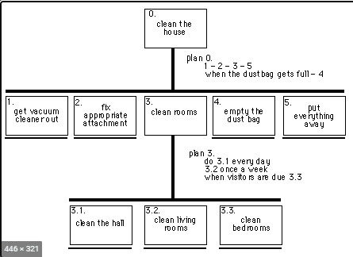

Slide 17
Generating the hierarchy
Get list of tasks
    start with stating the overall objective that the person has to achieve.
Re-describe into a set of sub-operations and the plan specifying when they are carried out.
    group tasks into higher level tasks
    decompose lowest level tasks further
    Each sub-operation can be re-described further if the analyst requires

Slide 18
Make an HTA for making a cup of tea.

Slide 19
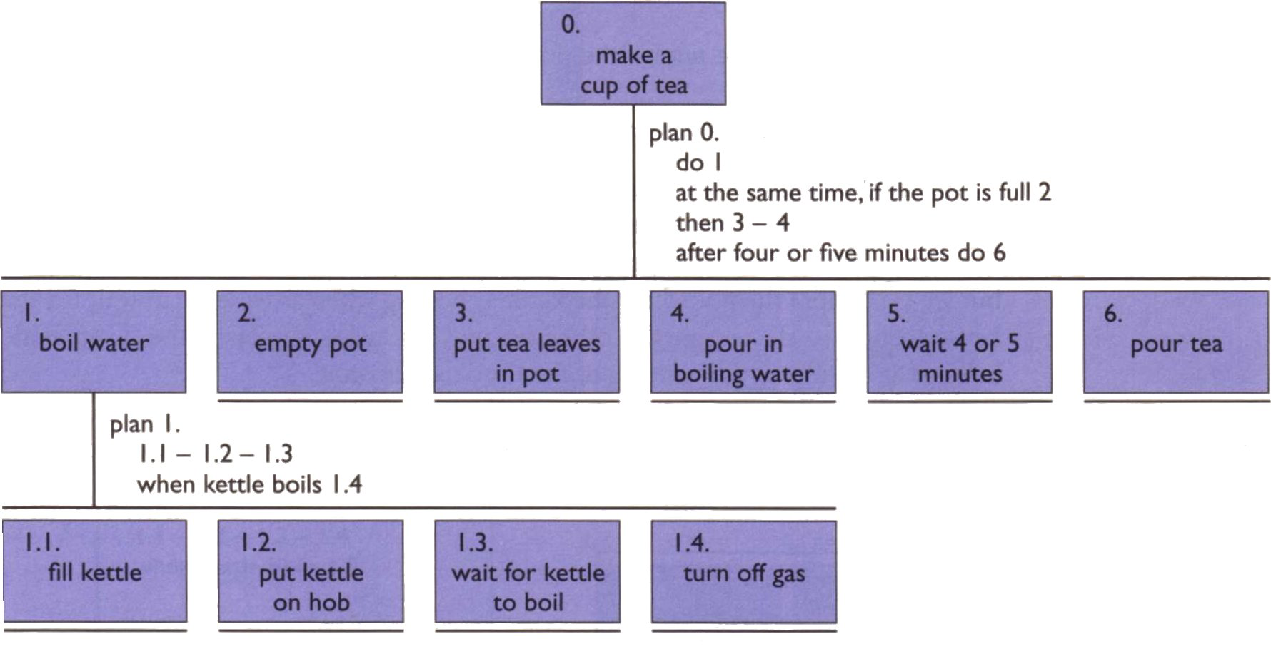
An Example HTA

Slide 20
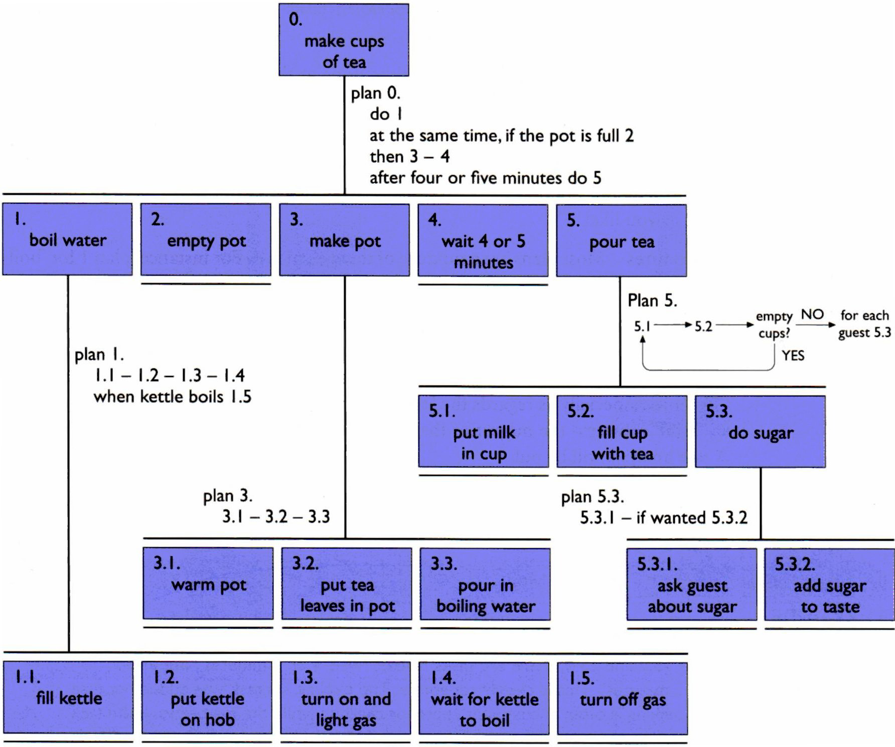
Refined HTA
Notes:
Sequence => 1.1 then 1.2 then 1.3
Optional => if the pot is full 2
Wait => when kettle boils, do 1.4
Cycles => do 5.1 5.2 while there are still empty cups
Parallel => do 1; at the same time ...
Discretionary => do any of 3.1, 3.2 or 3.3 in any order
Mixtures => mixture of above

Slide 21
Stopping rules
How do we know when to stop?
  Is “empty the dust bag” simple enough?
  Purpose: expand only relevant tasks
  Motor actions: lowest sensible level
P × C rule
  If the probability of making a mistake in the task (P) multiplied by the cost of the mistake (C) is below a threshold, then stop expanding.
  That is, simple tasks need not be expanded, unless they are critical.

Slide 22
Restructuring HTA
Restructuring and finding the appropriate and meaningful hierarchy, is part of the process of HTA.
For Example:
  If we know that we only ever notice the bag is full when we are actively using the machine, we might choose to put subtask 4 ‘empty the dust bag’ within 3 ‘clean the rooms’.

Slide 23
Refining HTA
Given initial HTA (textual or diagram)
  How to check / improve it?
Some heuristics:
  paired actions e.g., where is `turn on gas'
  restructure e.g., generate task `make pot'
  balance e.g., is `pour tea' simpler than making pot?
  generalise e.g., make one cup ….. or more
Notes:
Paired Actions: This heuristic suggests looking for pairs of related actions that might be better grouped together. For example, instead of having separate tasks for "turn on gas" and "ignite burner," you might combine them into one task like "start cooking.“
Restructure: This involves reorganizing tasks to make them more intuitive or efficient. For instance, if your initial HTA has "boil water" and "make tea" as separate tasks, you could restructure it into a single task called "brew tea" to streamline the process.
Balance: This heuristic encourages evaluating the complexity or difficulty of tasks relative to each other. For example, if "pour tea" is more complex than "make pot," you might want to reconsider the hierarchy or break down "pour tea" into simpler subtasks.
Generalize: Here, you're looking for opportunities to create more general tasks that encompass multiple specific instances. For instance, instead of having separate tasks for making one cup of tea and making multiple cups, you might have a general task called "prepare tea" that can be applied to any quantity.
By applying these heuristics, you can enhance the clarity, efficiency, and usability of your HTA, whether it's a textual description or a diagram.

Slide 24
Types of Plans
Sequence
    1.1 then 1.2 then 1.3
Optional
    if the pot is full 2
Wait
    when kettle boils, do 1.4
Cycles
    do 5.1 5.2 while there are still empty cups
Parallel
    do 1; at the same time ...
Discretionary
    do any of 3.1, 3.2 or 3.3 in any order
Mixtures
    Mixtures of above

Slide 25
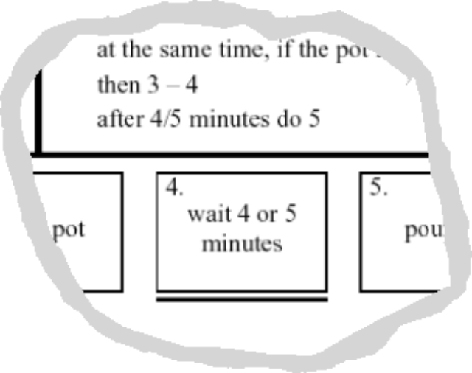
Waiting …
is waiting part of a plan?
… or a task?
generally
  task – if ‘busy’ wait
    you are actively waiting
  plan – if end of delay is the event
    e.g. “when alarm rings”, “when reply arrives”
in this example …
  perhaps a little redundant …
  TA not an exact science

Slide 26
HTA Pros
Economical method of gathering and organizing information
Enables the analyst to focus on crucial aspects of the task
Allows functional objectives to be specified at the higher levels of the analysis prior to final decisions
A collaboration between the task analyst and people involved in operations.
Can be used as a starting point for using various error analysis methods to examine the error potential

Slide 27
HTA Cons
The analyst needs to develop a measure of skill in order to analyze the task effectively since the technique is not a simple procedure that can be applied immediately.
Because HTA has to be carried out in collaboration with workers, supervisors and engineers, it entails commitment of time and effort from busy people

Slide 28
Class Activity 1
Consider the activity of making a telephone call. Record the actions in an HTA diagram or textually. Start off simply, assuming you know the number to dial, but then add more complicated situations: finding the number in address book, or what to do when the number is engaged.

Slide 29
Class Activity 2
Using an ATM to Withdraw Cash
Task: Withdraw money using an ATM.
Simple version: You know your PIN and the amount you want to withdraw.
Extended version: Add steps for when the machine rejects the card, runs out of cash, or you forget your PIN.
Construct an HTA (diagram or text) for withdrawing money using an ATM.
Start simply, assuming a smooth transaction. Then add complexity such as:
Card not detected
Incorrect PIN entered
ATM out of cash
User wants a receipt

Slide 30
Class Activity 3
Task: Submit a digital assignment on the university portal.
Simple version: You already have your file and know where to upload it.
Extended version: Add challenges such as file upload failure, wrong file format, or verifying submission.
Record the actions in an HTA for submitting an assignment on the LMS.
Start from locating the correct course page and upload section.
Then extend to include:
File naming and formatting
Handling upload errors
Checking submission status or receipt confirmation

